Slide 1
Understanding the market in Canberra, Australia
Final project for the IBM Data Science Professional Certificate
J. Siddall

Slide 2
Objectives
I have been approached by a group of businesses, from overseas, interested in understanding:
where younger adult/medium-high income Canberrans cluster, and
existing competition in the Canberra area.
Analysing these two issues together will provide business intelligence to inform the selection of optimal locations for establishing new business enterprises in the Canberra area.

Slide 3
Data Sources
2011 Australian Bureau of Statistics (ABS) census data
Foursquare location data

Slide 4
Data CLEANING
Transforming data types
Pivoting/stacking data tables
Renaming and reordering columns
Applying basic calculations across cases (e.g. sum)
Dropping redundant features
Computing new variables required for the analysis

Slide 5
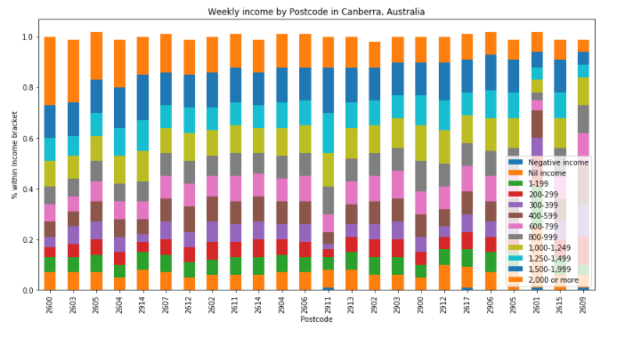
Data ANALYSIS

Slide 6
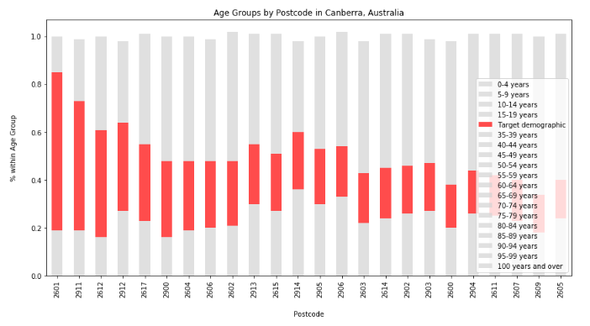
Data ANALYSIS (continued…)

Slide 7
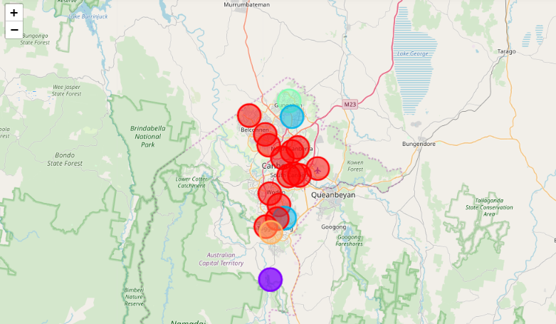
Segmentation and clustering – Where is the market competition?
Red seemed to indicate a proximity (within 2,000 metres) to places like hotels, cafes and restaurants.
Light blue indicated proximity to lakes and fast food restaurants.
Green indicated a single unique postcode more proximate to places such as athletics and sports venues, rather than cafes/hotels.
Purple indicated an outlier in the facilities available, probably due to remoteness (being located far away from the city’s centre).
Orange was an oddity, with the most frequent venue being cupcake shops and wine bars. As a local who is familiar with the southern Tuggeranong area, this makes sense.

Slide 8
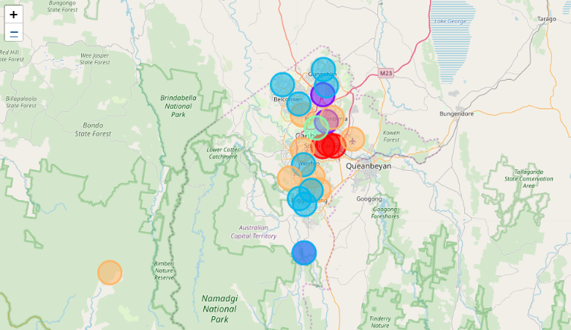
Segmentation and clustering – Where is our target demographic?
Explore opportunities in the Gungahlin region of Canberra.
Gungahlin market competition in the food and entertainment industry if comparatively lower than other Canberra regions. At the same time, the demographic makeup of Gungahlin is like Belconnen, in that it is mostly middle income older and younger adults.
Avoid the market saturated areas of Civic and Kingston.
Although these areas attract high-income cohorts there is already an established food and beverage industry here.
Avoid areas marked in orange on the second map, if your target market is high-income earners.
While business opportunities can be found across income brackets, if your target group is high-income earners the orange clusters have identified low-middle income areas.

Slide 9
Thank you

